Slide 1
Software as a Service
SaaS (Software as a service)
SaaS provides an internet-based access to s/w applications.
No inhouse h/w, s/w required to host the application.
The user is relived of maintaining any licenses, patches for the provided software.
The user can use the s/w on the subscription basis and pay for only the duration it was used.
Licensing cost of the s/w can be optimized by increasing the average utilization of licensed s/w.
No Patch management required or other complexities of maintaining software.

Slide 2
Software as a Service
SaaS Origin & Evolution
While many people think of SaaS as a modern business model, it dates to the 1960s. Early SaaS systems relied on “dumb” terminals (monitors and keyboards without a processor) connected to a mainframe. Small enterprises, academic institutions, and government organizations could use this technique.
Emergence of internet has boost up the SaaS.
In 1999, Salesforce jumped in with the customer relationship management (CRM) platform as the first SaaS solution built from scratch & succeeded over time. Salesforce led the way to prove that SaaS is the future of software delivery.
Customer relationship management (CRM) is a technology for managing all your company’s relationships and interactions with customers and potential clients. The goal is simple: Improve business relationships. A CRM system helps companies stay connected to customers, streamline processes, and improve profitability.
https://www.salesforce.com/in/crm/what-is-crm/#whatis

Slide 3
Software as a Service
SaaS Origin & Evolution
Initially, the SaaS model was identified as built for startups and small businesses, just a fad or not stable enough to manage larger business applications.
But over the next several years, it made a revolutionary success through a wide adoption rate. The exponential growth of SaaS and limitless functionality made it a valid option even for enterprise-level businesses. Businesses started moving away from single-use or perpetual licenses to subscription-based licenses due to low upfront costs and better scalability.
After the emergence of COVID, remote work has become a part of life. Businesses that can’ go on with physical offices and had to rely more & more on such online solutions for tackling the rapid surge in demand for remote services and higher agility to adapt to swiftly fluctuating market circumstance

Slide 4
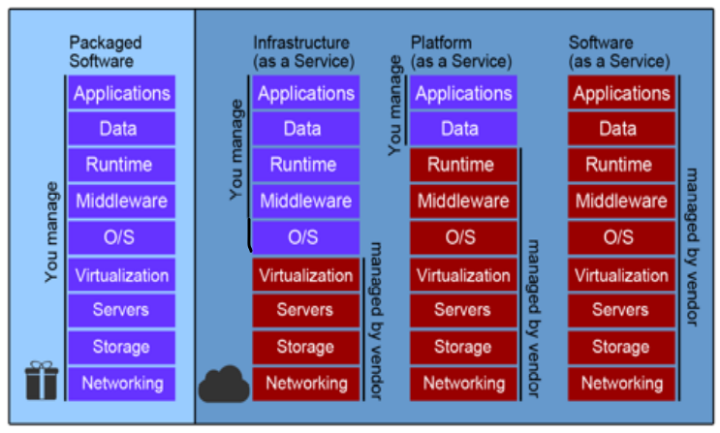

Slide 5
Software as a Service
Salesforce.com Approach: S/w environment of salesforce.com have the following list of components:
Multi-tenancy foundation: Every user’s private code is stored in a separate container, and it is isolated from other containers within a multi-tenant architecture.
Metadata: It allows every users data and customized logic to be managed separately, it is an architectural approach.
Infrastructure: The Salesforce.com application environment is based on infrastructure data center environment. This includes capabilities namely middleware, database management, performance monitoring and management, security, etc.
Database: On the top of oracle database there is a set of database services. These database services includes ways to manage documents that are used by Salesforce.com application, data objects and data fields.

Slide 6
Software as a Service
Salesforce.com Approach: S/w environment of salesforce.com have the following list of components:
Integration: This set of standardized web services APIs enables applications to have a common approach to access information from one application to another (as well as data from other enterprise applications). If there is a standardized way to link one SaaS application to another service, customers or implementers don’t have to resort to custom coding.
Logic: This component includes services that create business processes (such as workflow, approval processes, and so on.) that the application uses.
User interface: This includes a framework and tools to build the way the application appears to the customer.

Slide 7
Software as a Service (SaaS)
Desirable Characteristics in Software as a Service
SaaS application must include measuring and monitoring so that consumers can make real use.
A SaaS application must have built-in billing service.
The SaaS application should be quite simple so that most consumers are interested in the service.
Advanced navigation and ease of use for SaaS applications.
SaaS application must be modular.
The integrity of customer data need to be protected by SaaS applications.
Fast releases of new features and new capabilities are needed to be provided by SaaS applications constantly.

Slide 8
Software as a Service (SaaS)
SalesForce.com ecosystem
Ecosystem means technical and marketing partner of a SaaS provider.
Salesforce.com’s ecosystem is Force.com.
Force.com is a Platform as a Service (PaaS) product designed to simplify the development and deployment of cloud-based applications and websites.
Developers can create apps and websites through the cloud IDE (integrated development environment) and deploy them quickly to Force.com's multi-tenant servers.
Ecosystems is an essential part of the SaaS business model.

Slide 9
Software as a Service (SaaS)
SaaS economics
The traditional and still existing license software model economics is different to the economics of the SaaS market.
The consumer gives the whole charge of authorizing to the software and give the additional charge to shelter conservation and provision per year in the existing and traditional license model.
With the traditional license model approach, the maintenance can be as less as 10 percent or even as high as 25 percent of the purchase price.
IT costs which includes support services and hardware renewal and so on.
Purchase cost + maintenance cost + IT cost (h/w cost, training cost, s/w renewal cost, another s/w required to run that s/w)
In case of SaaS, model is based on subscription price.
Subscription price is calculated based on initial investment in SaaS development, ecosystem, number of present subscribers, and maximum number of subscribers which can be accommodated, and the number of years in which company is expecting to get the profit.

Slide 10
Software as a Service (SaaS)
Hurdles in SaaS
The initial cost or capital investment to build the type of data center and applications that can scale to support millions of individual users or thousands of companies.
To convert to a long-term contract for a free one-month trial, a great deal of time and effort is required.

Slide 11
Software as a Service (SaaS)
Types of SaaS platform
Packaged software
Collaborative software
Enabling and management tools

Slide 12
Software as a Service (SaaS)
Packaged software
The packaged software is designed with specifically integrated business processes that customers can customize.
Packaged software is the largest area in the SaaS market.
Packaged software is available in several forms, such as human resources, financial management, customer relationship management, supply chain management, etc.

Slide 13
Software as a Service (SaaS)
Collaborative software
This type of SaaS software focuses on all types of collaborative activities.
It includes project planning, instant messaging, web conferencing, document collaboration and even e-mail.
Since, teams are located all over the world, collaborative software is increasingly attractive on the market and is driven by Internet availability around the world.
The following are few companies which are focused on collaboration as a service:
Lotus Live is IBM’s collaborative environment.
Microsoft Live is Microsoft's collaborative environment.
Cisco Webex collaboration platform.
Google Apps of Google.
Zoho, an open source collaboration platform.
Citrix GoToMeeting

Slide 14
Software as a Service (SaaS)
Enabling and management tools
Enabling and management tools handles the following kind of SaaS:
Support the implementation and development of SaaS.
When creating and expanding a SaaS platform, developers also need to think about the measurement, testing and monitoring required by a customer and the developer.
Developer also need to think also about compliance issues involved in using this type of software in the real-world scenario.

Slide 15
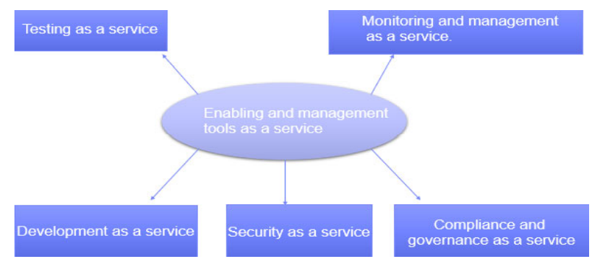
Software as a Service (SaaS)
Enabling and management tools
The five main different services area, namely:
Testing as a service.
Monitoring and management as a service.
Development as a service.
Security as a service.
Compliance and governance as a service.

Slide 16
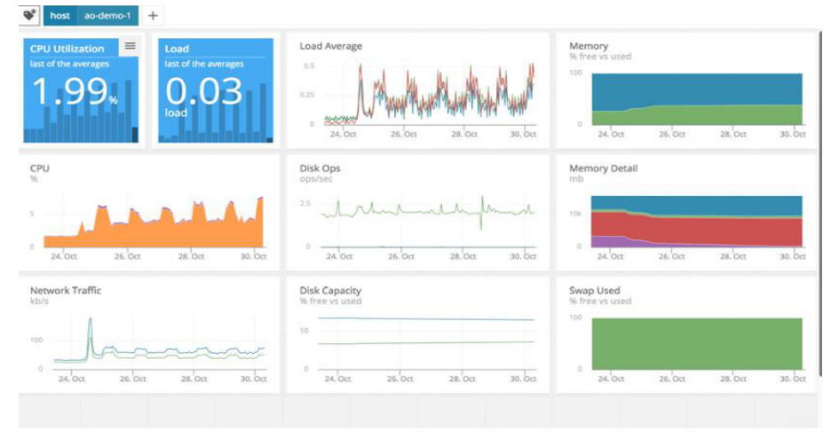
Software as a Service (SaaS)
Enabling and management tools

Slide 17
Software as a Service (SaaS)
SaaS (Software as a service) offering companies
Netsuite: offers a CRM base just like Salesforce.com
Intuit: offers a series of financial services products that support accounting services for small and medium enterprises.
RightNow: offers a set of CRM products, consisting of sales, marketing and various industrial solutions.
Taleo: attentions on talent organization jobs
SugarCRM: CRM platform
Webroot: SaaS security provider mainly e-mail filtering service
Atlanta technologies: Offers Data recovery solutions
Citrix online: offers an online remote assistance application.
SAP.

Slide 18
Software as a Service (SaaS)
SaaS will be the best option when
Applications in which there is a significant interaction between the organization and the outside world. For example, the campaign newsletter software via e-mail.
Applications that have a great need for web or mobile access. An example would be mobile sales management software.
Software that will be used only for short-term needs. An example would be collaboration software for a specific project.
Software where the demand increases significantly, such as billing or billing software that is used once a month.

Slide 19
Software as a Service (SaaS)
SaaS may not be the best option when
Applications where extremely fast data processing is required in real time.
Applications where legislation or other regulations do not allow data to be hosted externally.
Applications in which an existing local solution meets all the needs of the organization.

